Slide 1
4 Key Types of Data Analytics
1. Descriptive Analytics
2. Diagnostic Analytics
3. Predictive Analytics
4. Prescriptive Analytics

Slide 2
Descriptive analytics
Descriptive analytics refers to the process of analyzing historical data to understand what has happened in the past. It is the foundation of data analytics, used to summarize and interpret raw data to make it more understandable. Typically, descriptive analytics involves aggregating and visualizing data to find patterns, trends, and insights that help organizations make informed decisions..

Slide 3
Key features of descriptive analytics include:
Summarization: It uses techniques like averages, sums, counts, and percentages
to summarize large datasets.
Data Visualization: Charts, graphs, tables, and dashboards are common tools to
visualize data and make trends more evident.
Historical Analysis: Descriptive analytics only looks at past data and does not predict
future outcomes. Its purpose is to answer questions such as "What happened?"
Reporting: It generates reports that are essential for regular performance tracking,
helping businesses measure key performance indicators (KPIs).

Slide 4
Case Study: Retail Store Sales Performance
A nationwide retail chain, "FashionCo," is looking to improve its understanding of sales performance across its stores. The company operates in multiple cities and sells clothing, accessories, and footwear. They have been collecting sales data for years but haven't used this data to its full potential.

Slide 5
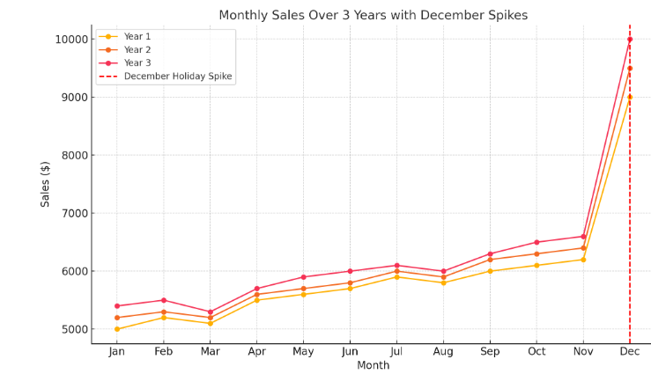

Slide 6
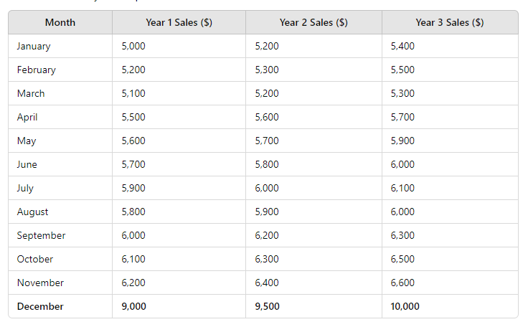

Slide 7
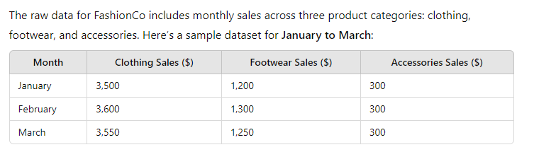

Slide 8
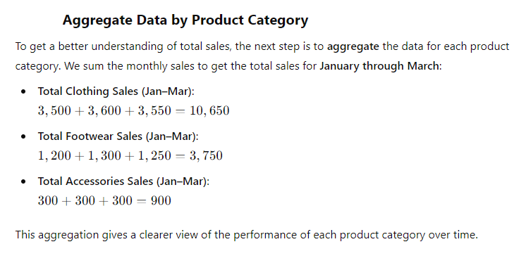

Slide 9
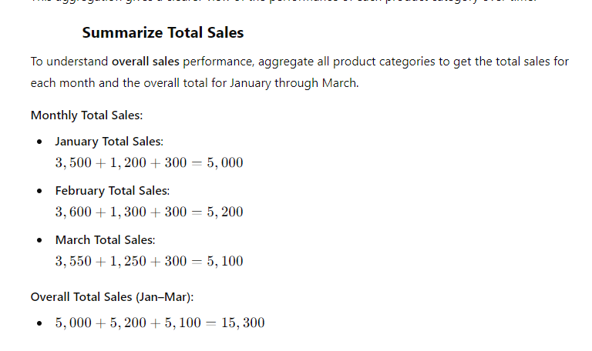

Slide 10
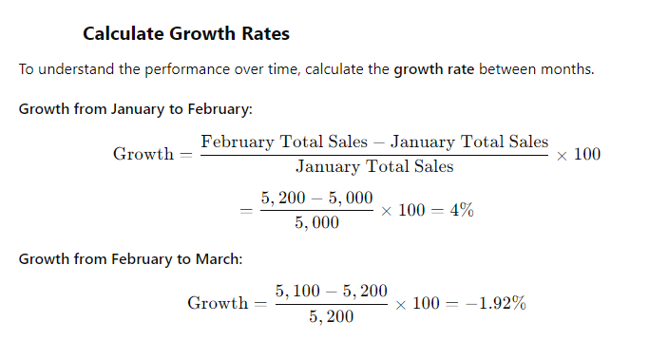

Slide 11
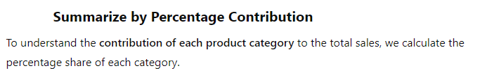
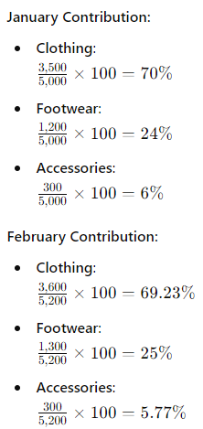
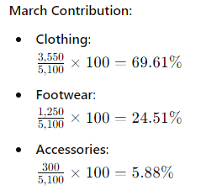

Slide 12
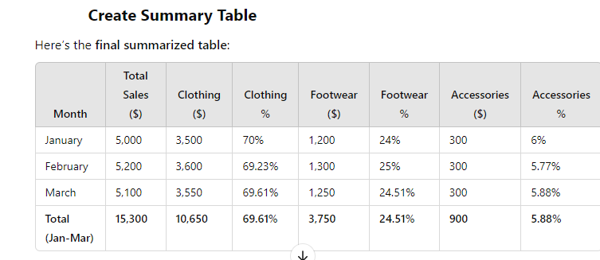

Slide 13
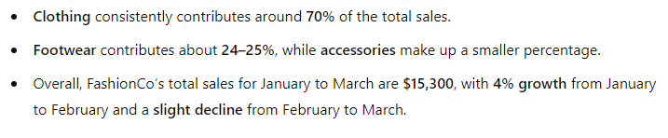

Slide 15
Diagnostic Analytics refers to the process of examining historical data to determine why something happened. Unlike descriptive analytics, which focuses on summarizing what happened, diagnostic analytics digs deeper to identify the underlying causes of observed outcomes or trends.

Slide 16
Key Aspects of Diagnostic Analytics:
Identifying Patterns and Anomalies: It looks for correlations, trends, and unusual behaviors in data.
Root Cause Analysis: Diagnostic analytics helps to uncover the reasons behind certain outcomes by analyzing data relationships.
Use of Statistical Techniques: Methods like regression analysis, drill-down, and data mining are commonly used to isolate factors contributing to the outcome.
Interactive Reporting: Tools like dashboards and visualizations help users investigate data in real-time and explore potential causes.

Slide 17
Predictive Analytics
Predictive Analytics involves using historical data, statistical algorithms, and machine learning techniques to predict future outcomes. The goal of predictive analytics is to forecast potential future events or trends, allowing businesses or individuals to make more informed decisions based on likely scenarios.

Slide 18
Predictive Analytics
Key Aspects of Predictive Analytics:
Data Patterns and Trends: Predictive models analyze past data to identify patterns and trends that can be extended to predict future events.
Machine Learning: It often involves advanced machine learning models, such as regression models, decision trees, neural networks, and time-series forecasting.
Probabilities and Scenarios: Predictive analytics doesn’t provide exact answers but estimates the likelihood of various outcomes happening.
Data-Driven Decision-Making: The insights gained are used to anticipate potential risks, opportunities, and trends, allowing for proactive strategies.

Slide 19
Prescriptive Analytics is an advanced form of data analysis that not only predicts future outcomes but also recommends specific actions to achieve desired results. It suggests the best course of action by analyzing data, considering business constraints, and optimizing for desired objectives. In essence, it answers the question: What should be done?

Slide 20
Recommendations for Action: Instead of just forecasting, prescriptive analytics provides actionable suggestions
to optimize decision-making.
.
Optimization Algorithms: Techniques like linear programming,
genetic algorithms, and heuristic methods are used to
provide the best outcomes under specific circumstances

Slide 21
conclusion
Descriptive Analytics: Summarizes historical data to show what happened.
Diagnostic Analytics: Explains why something happened by identifying causes.
Predictive Analytics: Forecasts future outcomes based on historical data.
Prescriptive Analytics: Recommends actions to optimize outcomes based on predictions.

